Slide 1


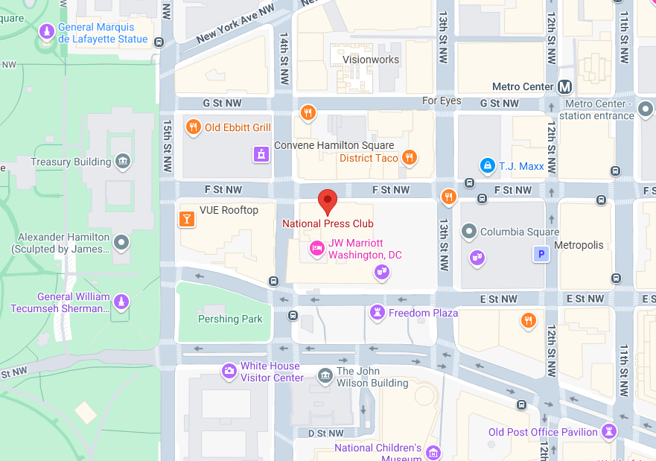
NIEMOpen Leadership Meeting National Press Club & Virtual
Date/time: 8 October 2025, ~ 9 AM – 4 PM
Venue: National Press Club
529 14th St NW, Washington, DC 20045
“DRAFT” Agenda

